Slide 1

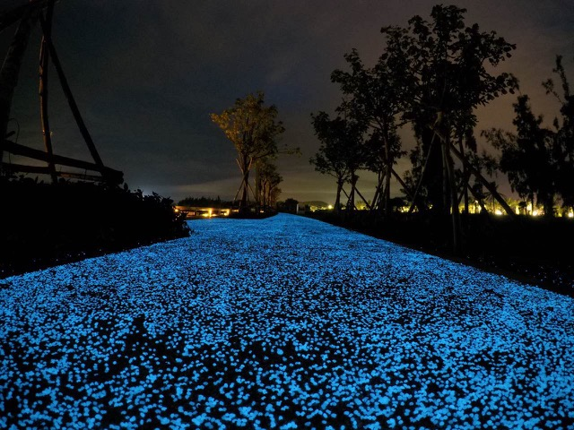

Starpath
The World’s first UV powered pathway

Slide 2
The World’s first UV powered pathway 2013.
This important green energy innovation is destined to play a big part in the mitigation of climate change and the drive to net zero.
Starpath is a simple compounded Eco-chip which is laid into the surface of concrete/tarmac at the time of installation these chips absorb UV rays during daylight hours and release it back as light energy at night.
The product is not only environmentally friendly but produces little or no light pollution crucial to the survival of nature.

Slide 3
This natural earth product is non-toxic with a long-life span lasts for many years + and requires no artificial power.
This maintenance free green energy solution has the ability to reduce the reliance on expensive and harmful street lighting currently in use today.
With this very viable option available worldwide serious choices will need to be made by people entrusted in the decision making process, of not only our futures but of future generations.
For further information please feel free to contact us.

Slide 4
Inventors of the world’s first UV powered pathway
Starpath Eco-chip is a compounded chip using a mixture of polymers to encapsulate the Strontium Aluminate particles.
Starpath Eco-chips are supplied in 25kg bags ready for use.
Starpath Eco-chips come in 2 x sizes 8-15mm or 16-20mm.
  (We recommend the larger chips are used unless fine detail is required for patterns and logo’s etc).
Starpath Eco-chips come in 3 colours.
  Blue, Green, Aqua.

Slide 5
5) We recommend a minimum dosage rate of 1kg of Eco-chips to 1 Sq/m of surface area. (Using more is fine).
6) The Temperature Range of the Eco-chip is. +280℃ and -50℃.
7) As the Eco-chips will be embedded into either concrete or tarmac the weight of what can be placed upon the pathway is going to be determined by the strength of the path.
8) The Eco-chips are designed for the use in concrete/tarmac any other medium would need to be discussed.

Slide 6
9) Please note the Starpath Eco-chips are Environmentally Friendly, Non-Toxic, Zero Energy, Zero Light Polluting.
10) The approximate glow time is 10 hours per night.
11) How the product works: The encapsulated Strontium Aluminate Particles absorb UV during the day light hours and releases it as light energy at night.
12) The Excitation Range for Strontium Aluminate range from 200nm to 450nm.

Slide 7
13) The Wavelength for the Green formulation is 520nm. Aqua is 505nm and the Blue 490nm.
14) The Chemical Formula is: Sr Al2 O4.
The Strontium Aluminate is usually fired at 1250℃.
15) Any size of chip and any colour can be used as a combination to create the desired effect of the pathway.

Slide 8
16) When laying a pathway using the Eco-chips firstly make sure that the initial pathway has been levelled flat near enough to how the final path will look, then place or scatter the chips to the desired configuration and in the case of concrete trowel the chips in flush with the top surface ensuring no chips are protruding above the finished surface.
As for Tarmac they will be rolled or compacted flush with the finished surface again ensuring no chips are protruding.
17) Once this process is complete, please ensure that no concrete or tarmac residue is left on the Eco-chips as this can seriously impede the chips’ ability to absorb the UV and emit the light. Please clean after installation.

Slide 9
18) As the product is a rare earth it is very much a part of nature. It therefore needs to be in its natural outside environment to work effectively. The presence of Human Artificial light will impact on the performance of the product so excessive ambient light will make the product appear as though it is not working, it is working, but the light is detracting from what it would look like in a dark area.
BE CAREFUL OF THIS.
19)The product is simple and easy to handle and is purely down to the creativity of the installation team as to how the path will look.

Slide 10
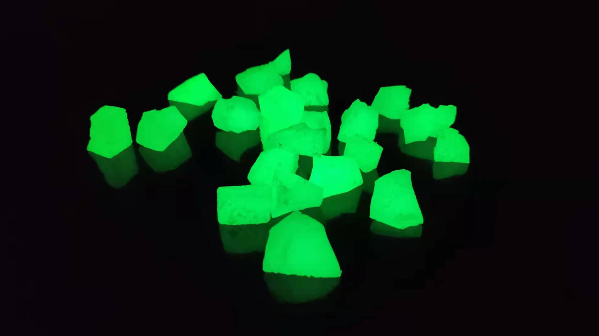
Starpath Eco-Chip

Slide 11


Slide 12
Supplied in: 25kg Bags
2 sizes: 8-15mm and 16-20mm
3 colours: Green, Blue, Aqua
Product is ready for use and needs to be dry at time of installation.
Do not store for long periods in direct sunlight as the product produces energy and may sweat if kept in closed containers.
The product is non-toxic and environmentally friendly, please refer to the Safety Data sheets for further information.
STARPATH INSTALLATION INSTRUCTIONS

Slide 13
Laid into concrete or tarmac at the time of installation. Once the initial wet surface has been prepared and laid, place or scatter the Eco-chips in the desired finished position. When using a concrete base: flatten into the surface flush using a trowel or mechanical float making sure none of the Eco-Chips are protruding above the concrete surface.
When using a tarmac base: once the surface has been rolled to the desired finish, place or scatter the Eco-Chips as desired and re-roll or compact making sure none of the EcoChips are protruding above the tarmac surface.
Application Method

Slide 14
Please note, after installation, with both concrete and tarmac surfaces the Eco-Chips will need to be cleaned making sure there is no residue left on the surface of the Eco-Chips. This is important as the Eco-Chips need to be able to absorb UV and emit it as light.
Either by hand or by mechanical stone applicator the eco-chips can be scattered or strategically placed to create shapes, patterns, logo’s etc.
Any combination of size or colour can be used when creating the pathway.
Application Method

Slide 15
We recommend the use of 1kg of product (regardless of chip size) to 1 sq/m of surface area as a minimum - any less than the recommended rate can seriously impact the performance of the product. Temperature range of the product: - 50°C to +280°C. All product should be laid in line with normal laying conditions for both concrete and tarmac.
Please Note:
Excessive ambient light will affect the visual appearance of the product.
Dosage Rates

Slide 16
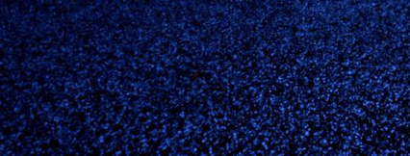
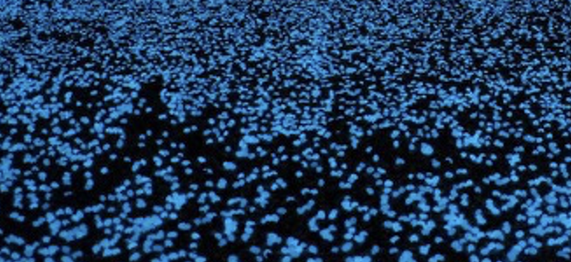
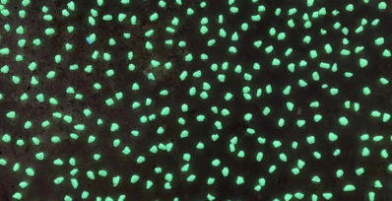
Starpath coverage

Slide 17
Please see the two pictures attached.
1kg of product covers 1sq/m of surface area.

Slide 18
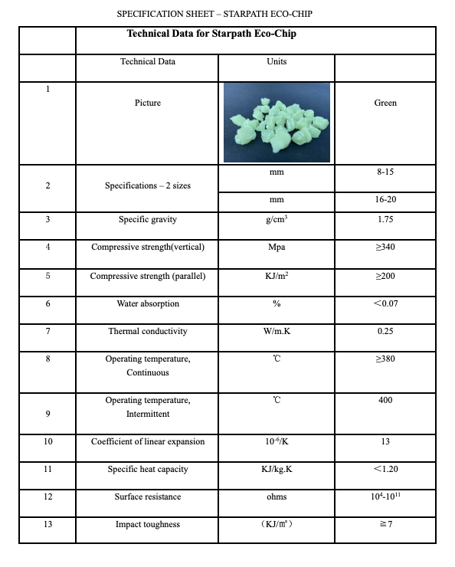
STARPATH ECO-CHIP
SPECIFICATION SHEET

Slide 19
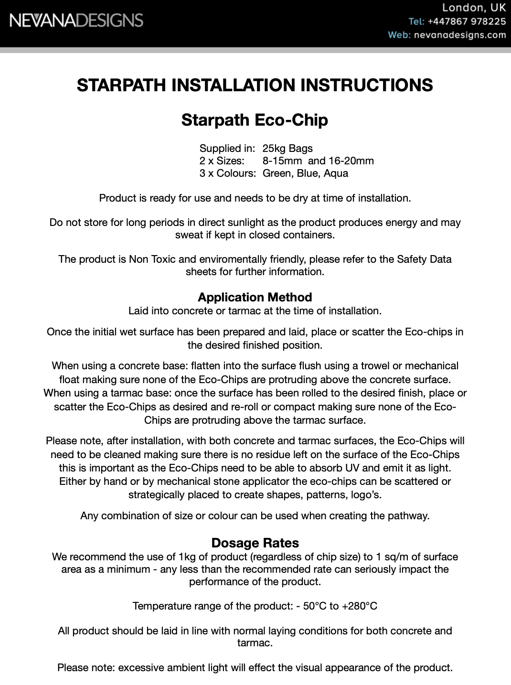

Slide 20
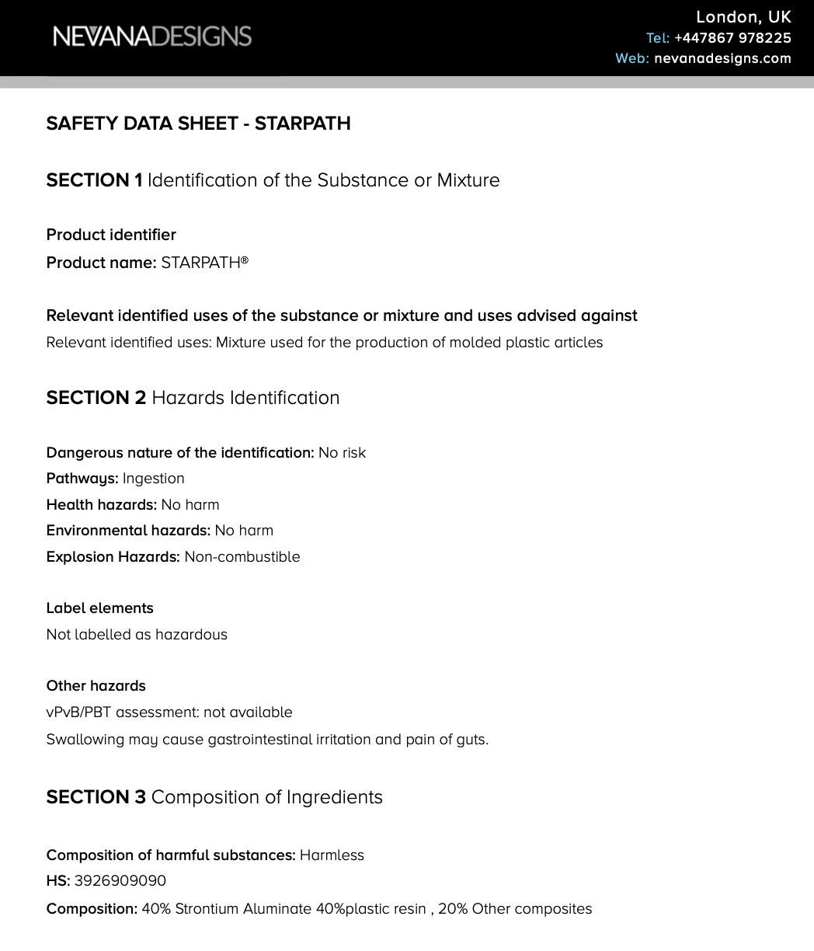


Slide 21
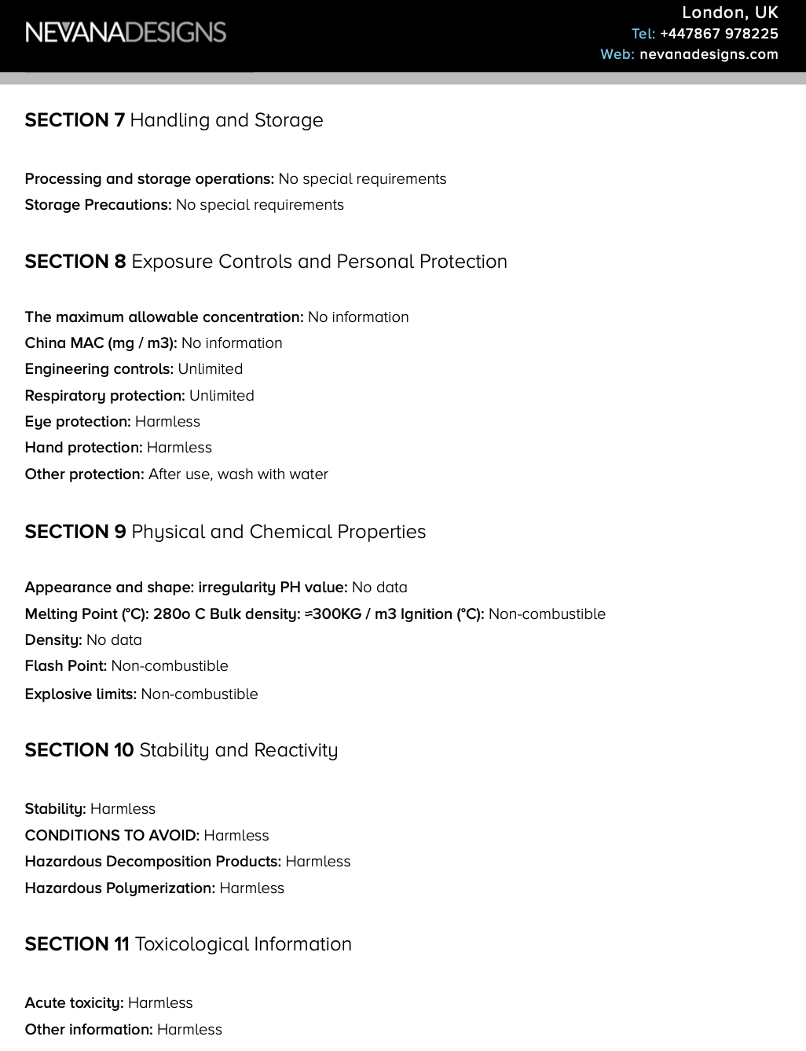
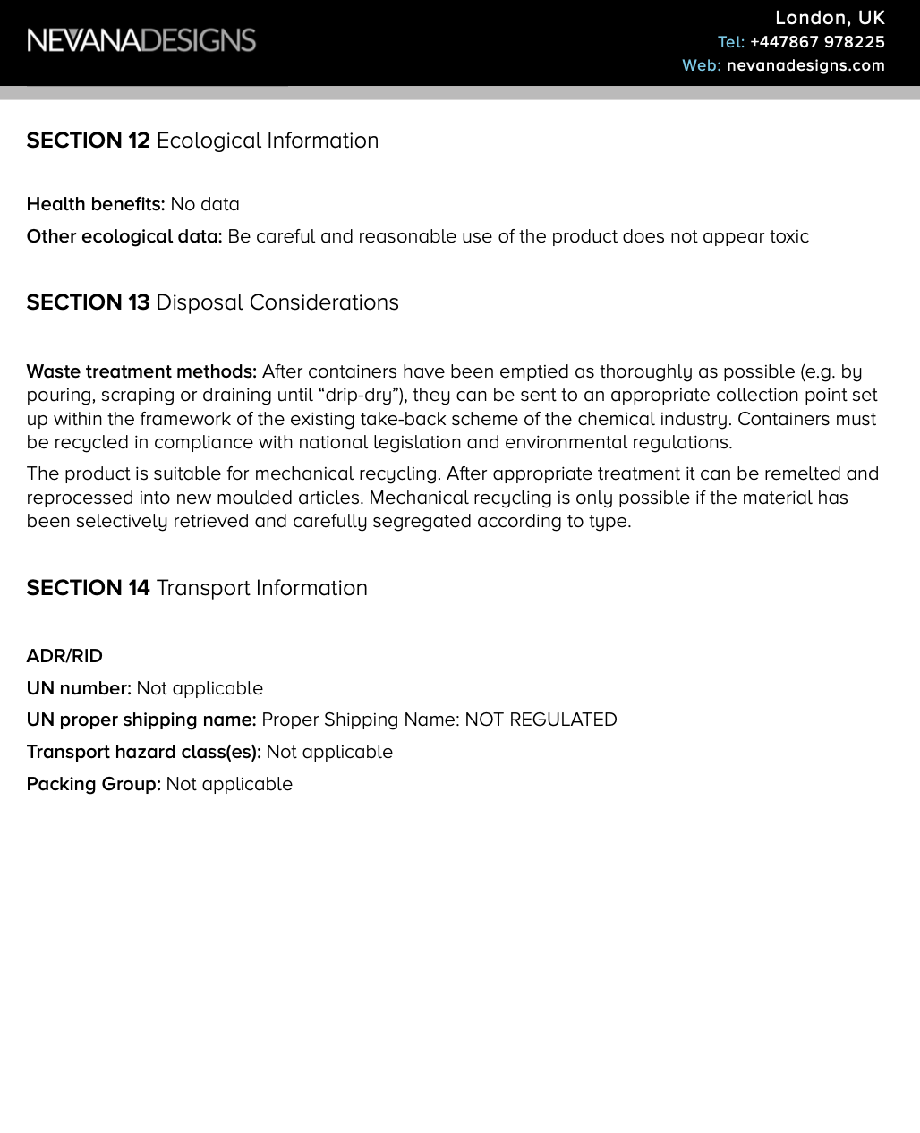

Slide 22
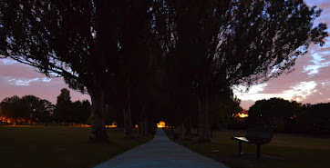

Slide 24
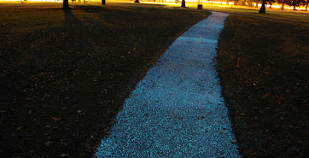

Slide 25
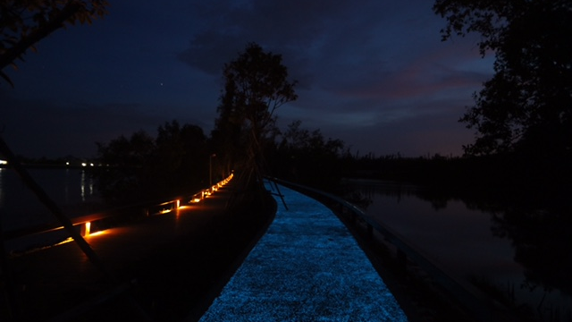

Slide 26
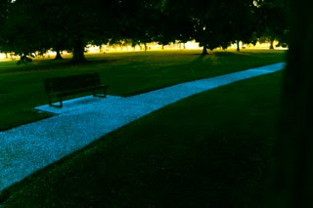

Slide 27
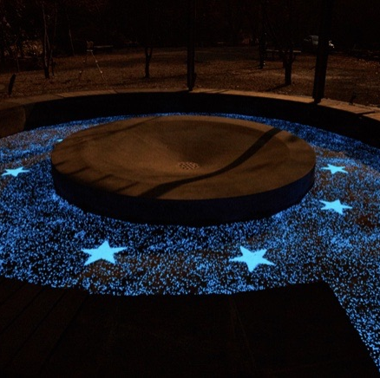
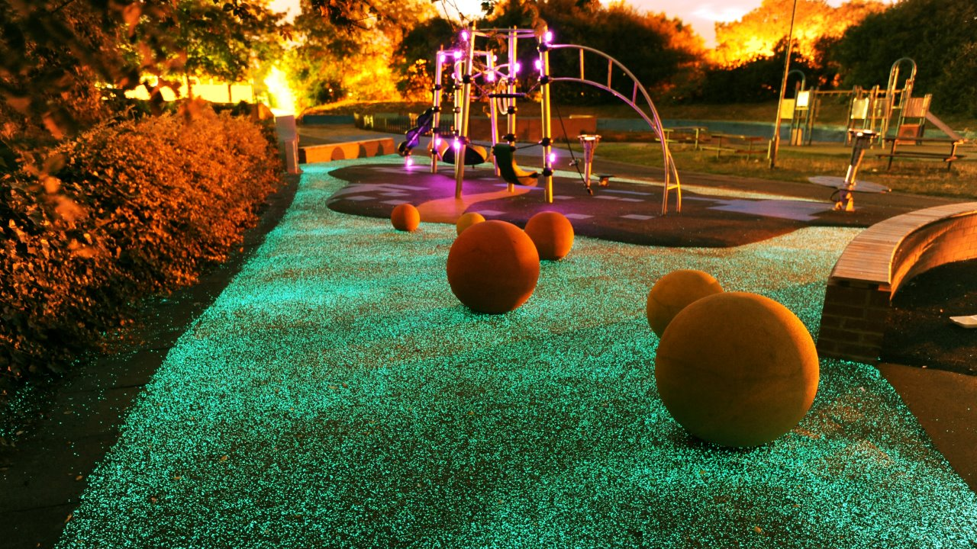

Slide 28
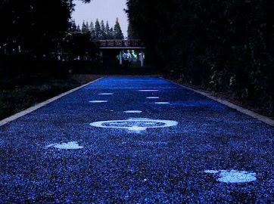

Slide 29
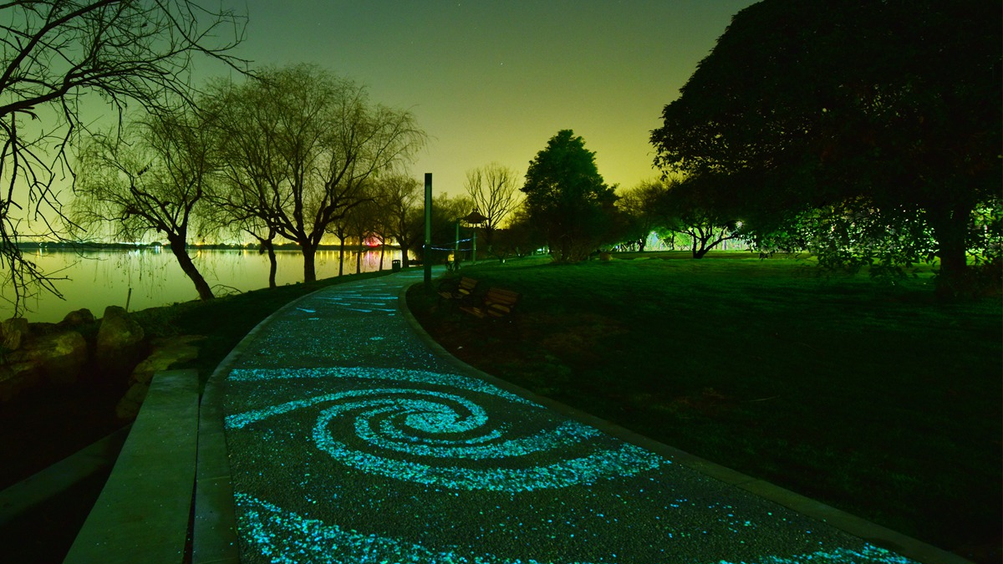

Slide 30
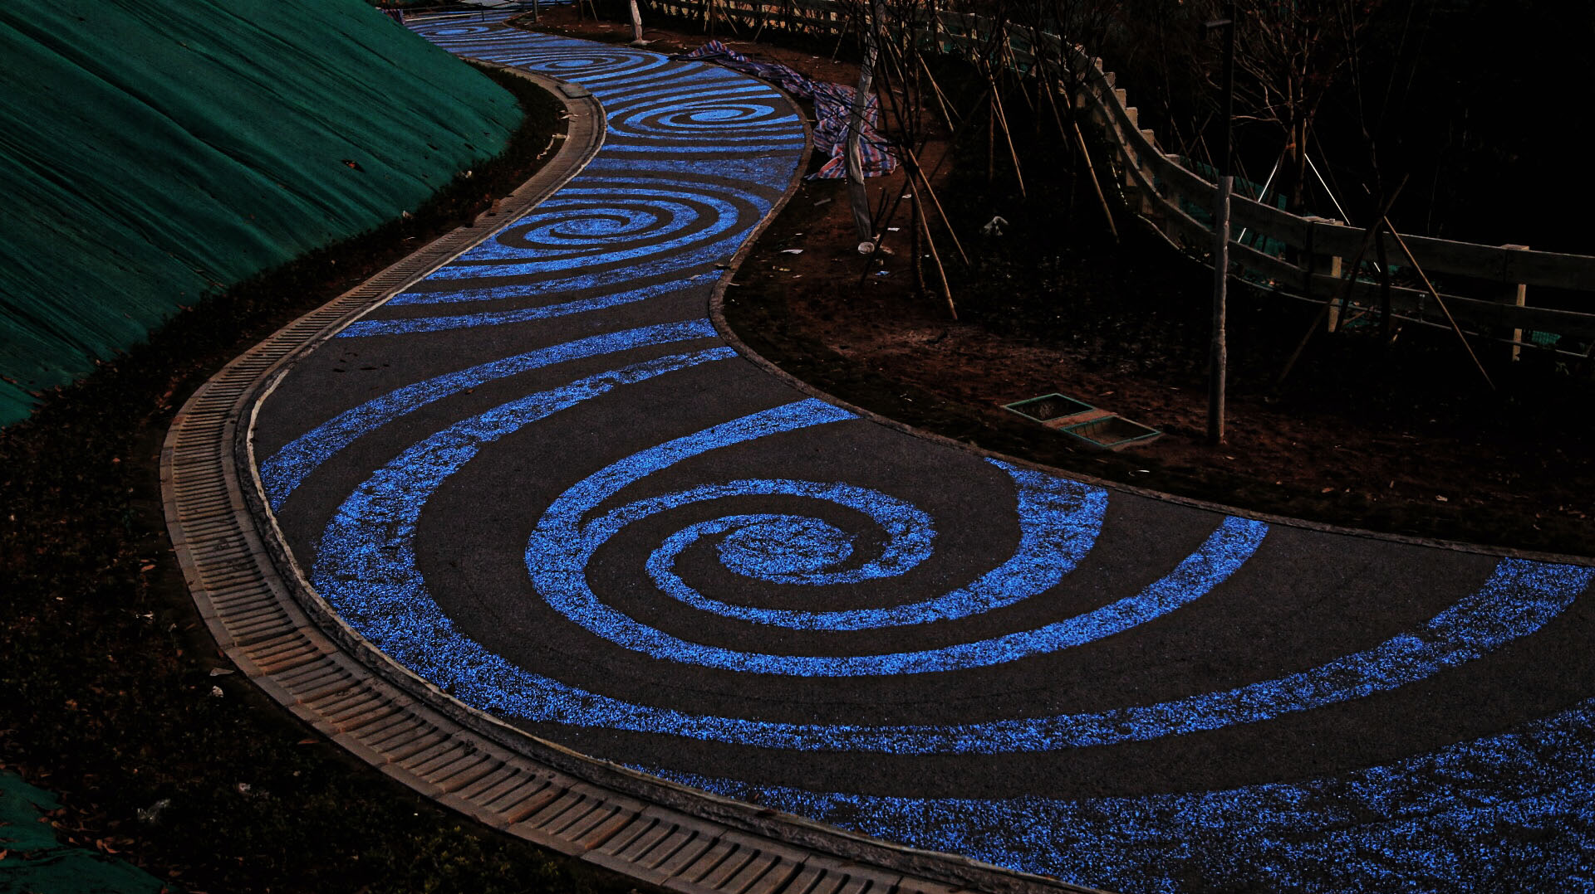

Slide 31
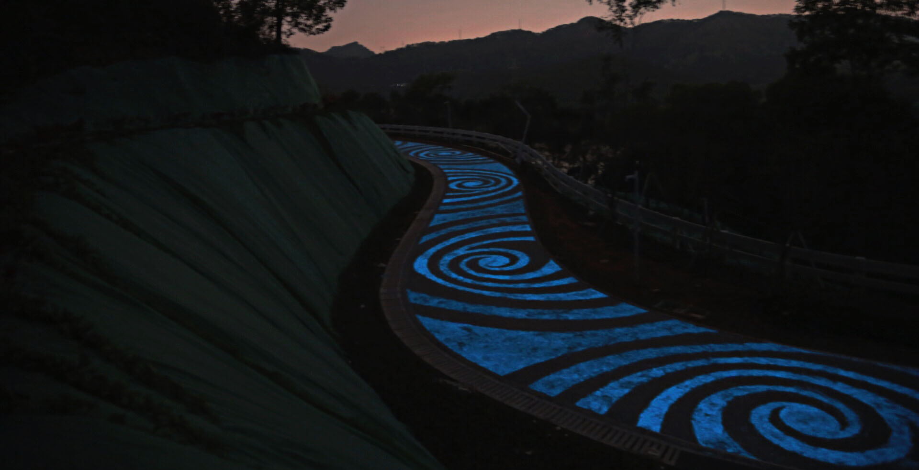

Slide 32
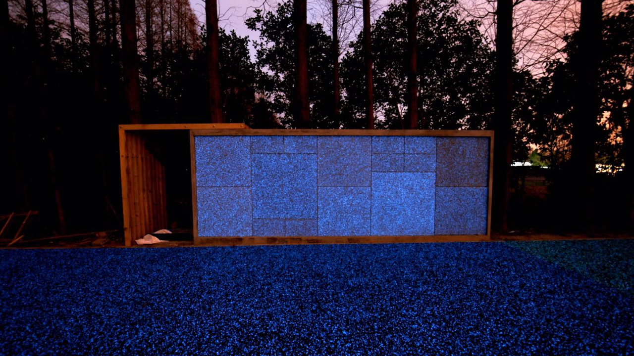

Slide 33
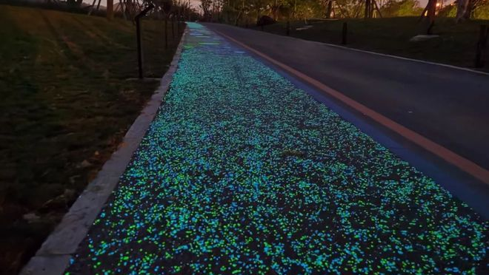

Slide 34
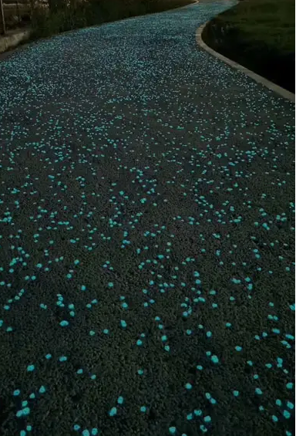
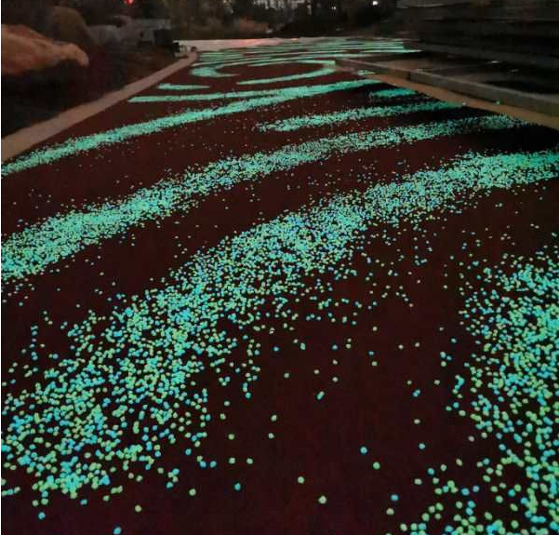

Slide 35
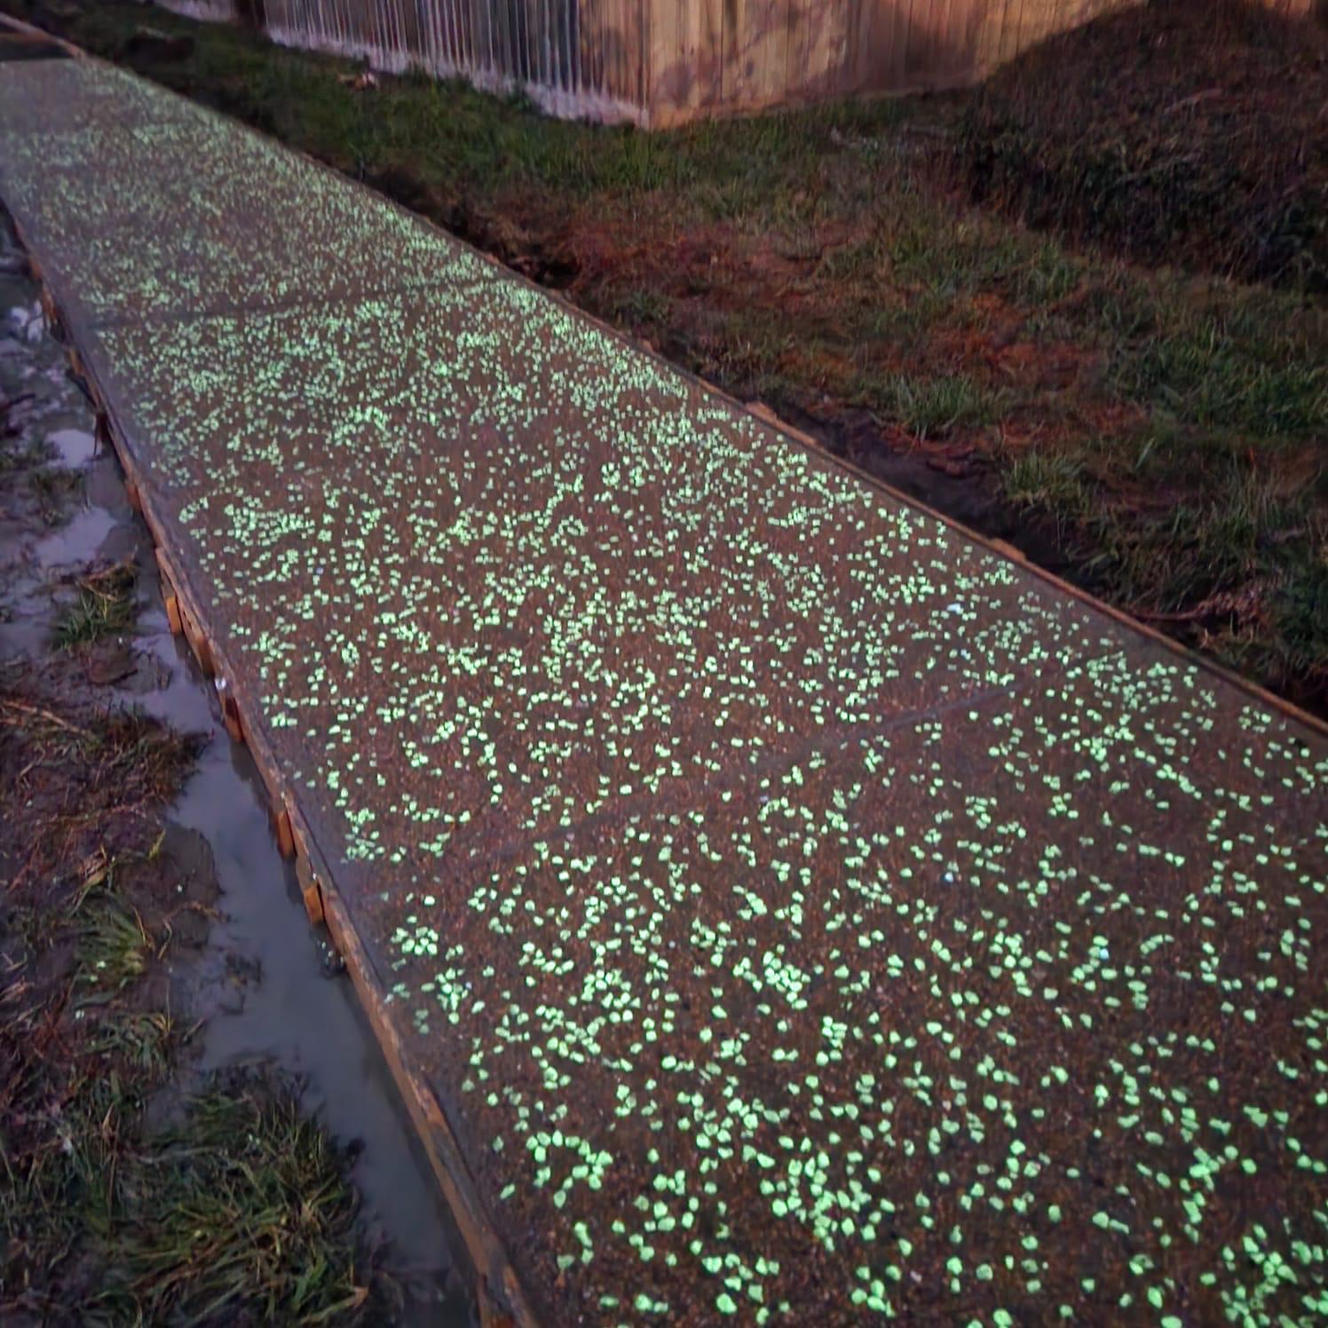

Slide 36
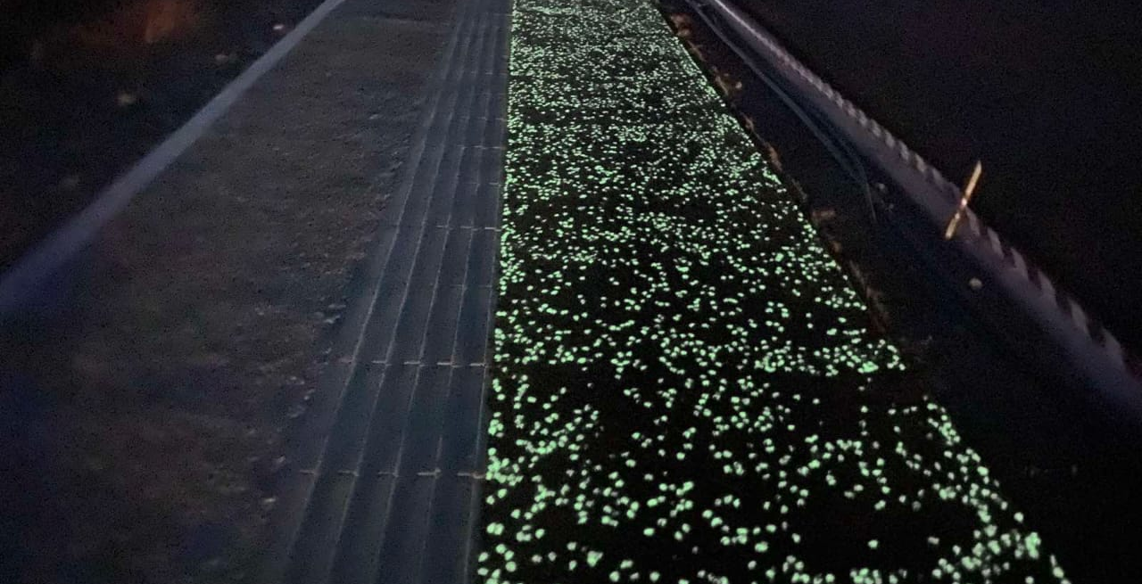

Slide 37
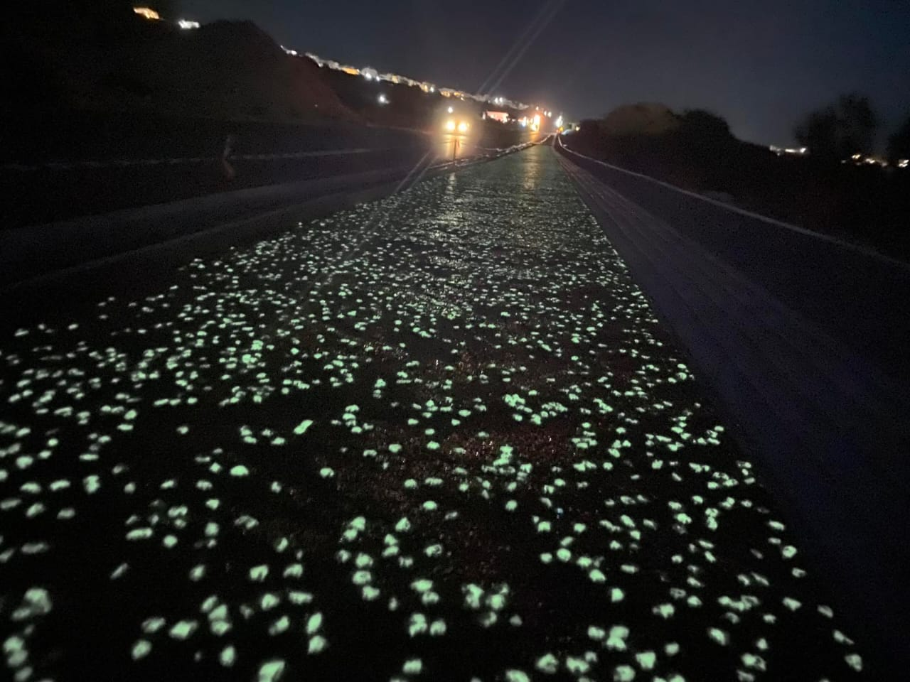

Slide 38
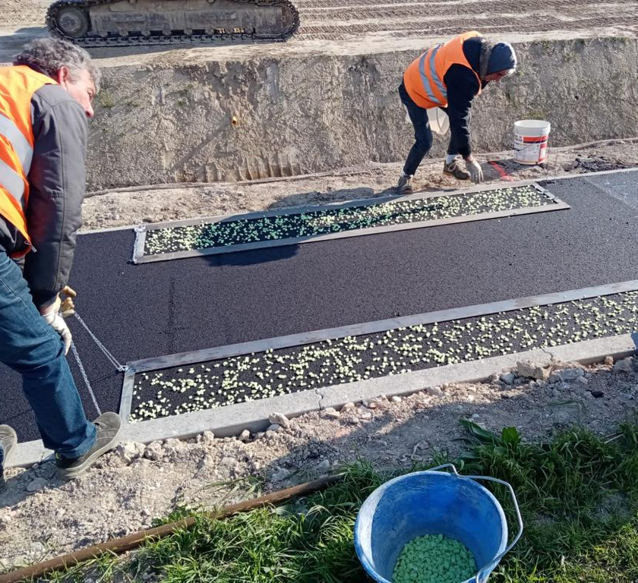
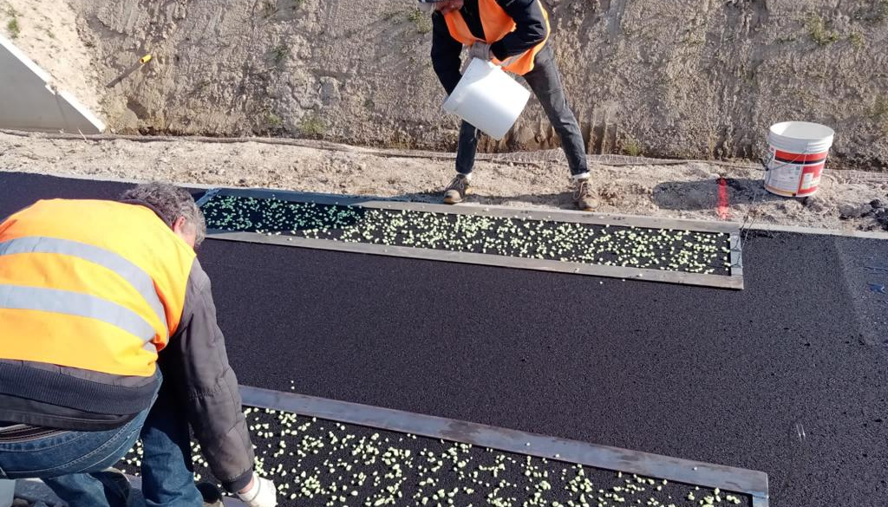
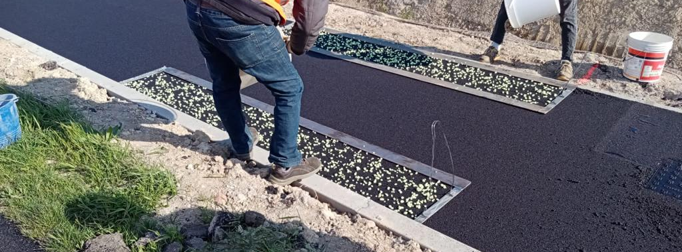

Slide 39
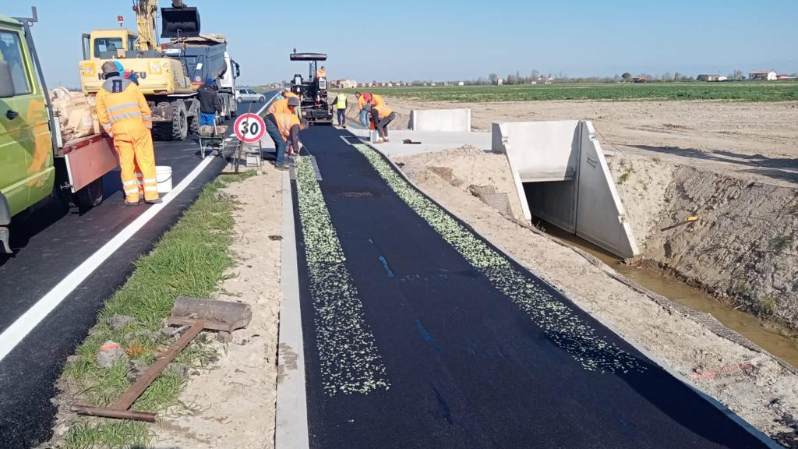

Slide 40
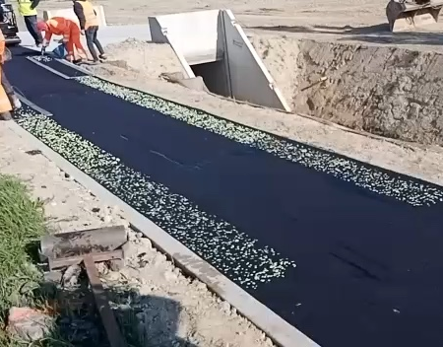
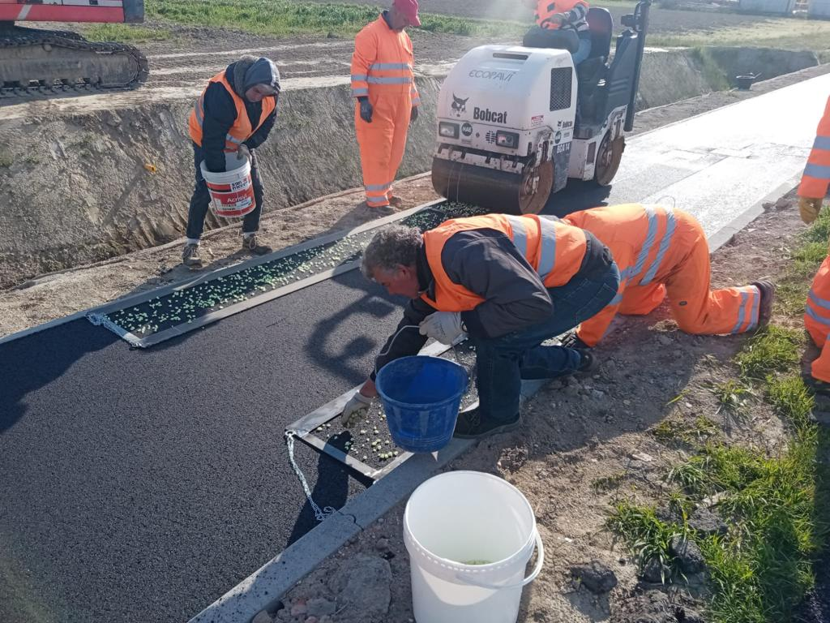
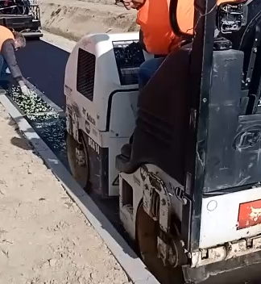

Slide 41
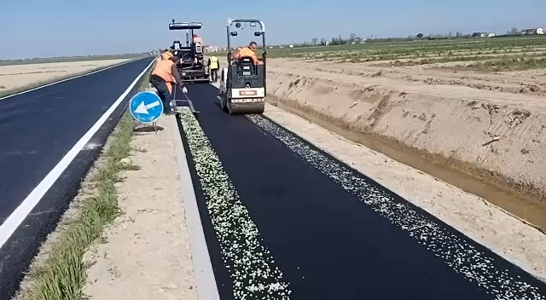
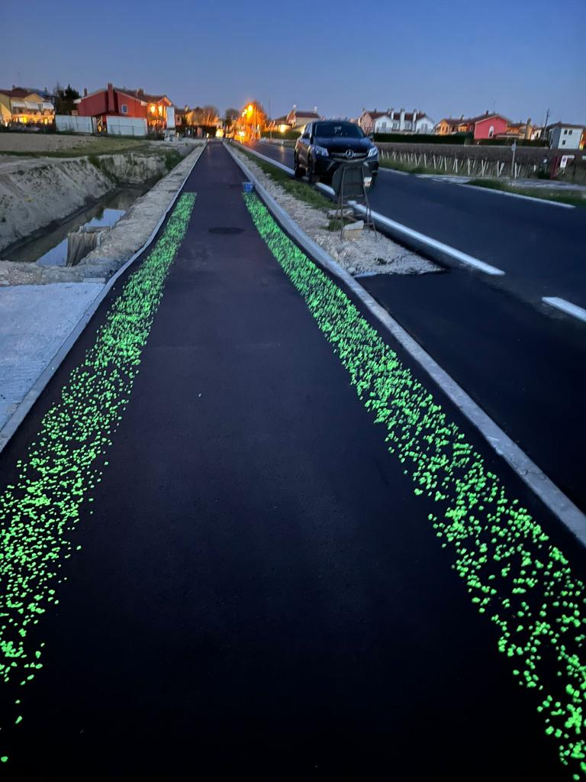

Slide 42
